Slide 1
Differentiable Predictive Control: From Offline Pre-Training to Safe Online Deployment
Ján Drgoňa
Associate Professor Civil and Systems Engineering Department The Ralph O'Connor Sustainable Energy Institute

Slide 2
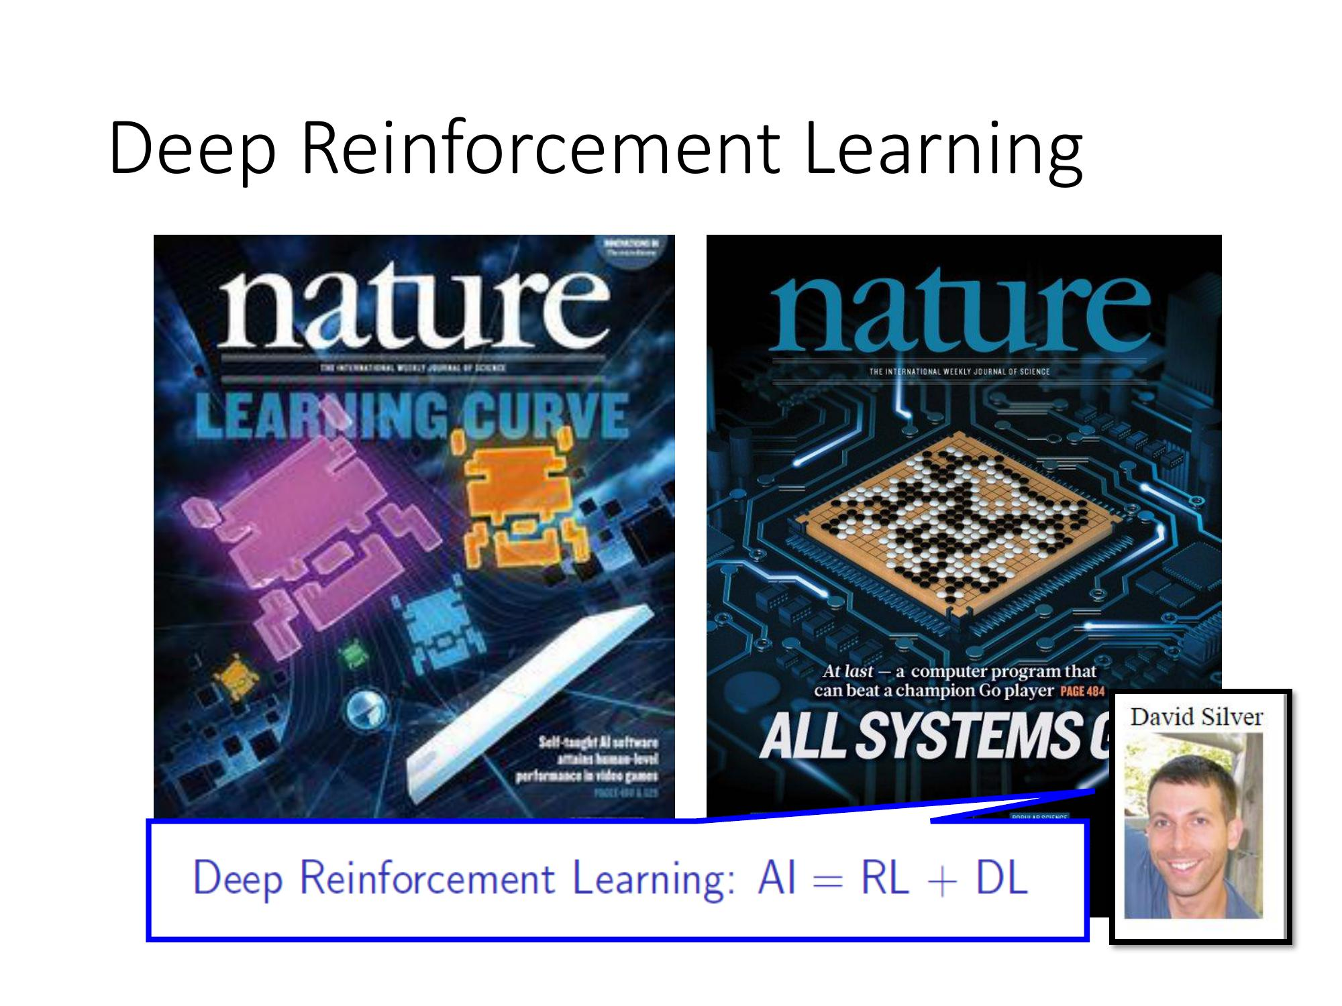
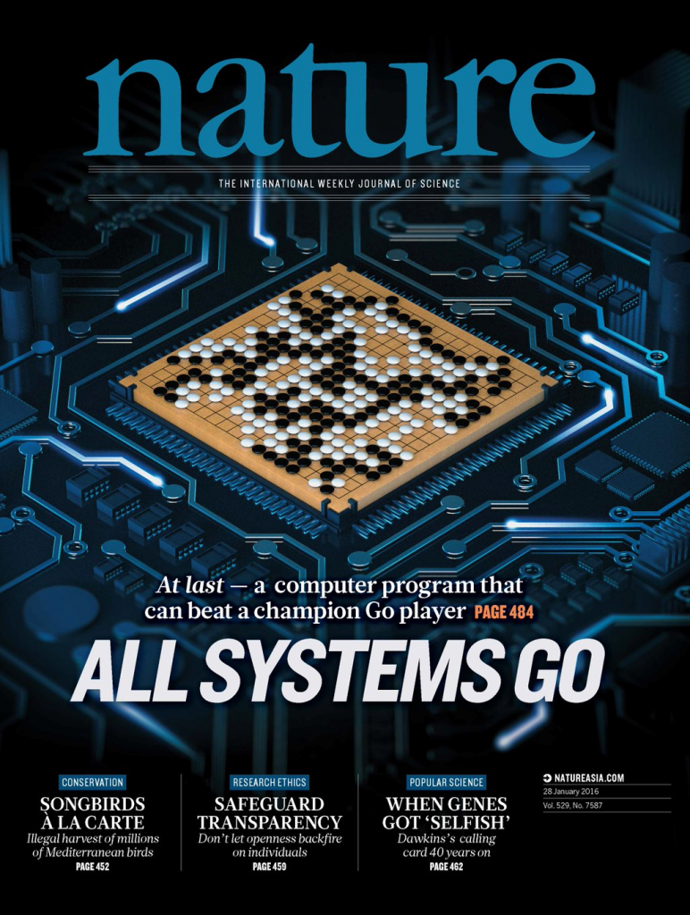
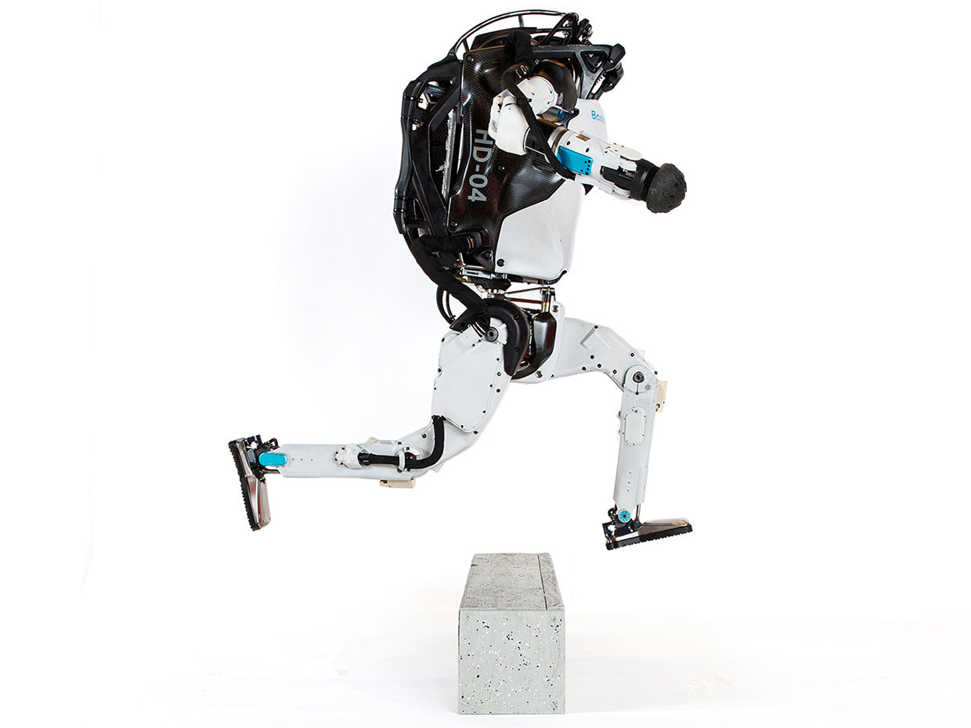
State of the Art Control Methods
Model Predictive Control
Reinforcement Learning
95% of the industrial control applications are PID loops & expert driven rule-based control (RBC).
The rest is model predictive control (MPC).
Everywhere where you have reliable digital environment model, and you can use compute resources to solve the problem offline. Successful in GenAI, games, and robotics.
James B. Rawlings, David Q. Mayne, Moritz M. Diehl, Model Predictive Control: Theory and Design, Nob Hill Publishing, 2nd ed., 2017
Richard S. Sutton and Andrew G. Barto, Reinforcement Learning: An Introduction, MIT Press, 2nd ed., 2018 Drgona J., et al. 2020. "All You Need to Know About Model Predictive Control for Buildings." Annual Reviews in Control, September 29, 2020
G. Dulac-Arnold, D. J. Mankowitz, and T. Hester, “Challenges of real-world reinforcement learning,”, 2019.

Slide 3
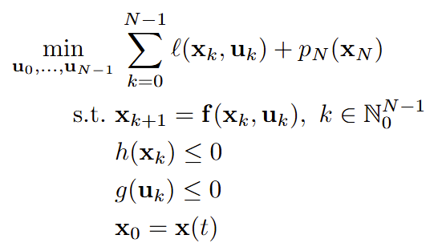
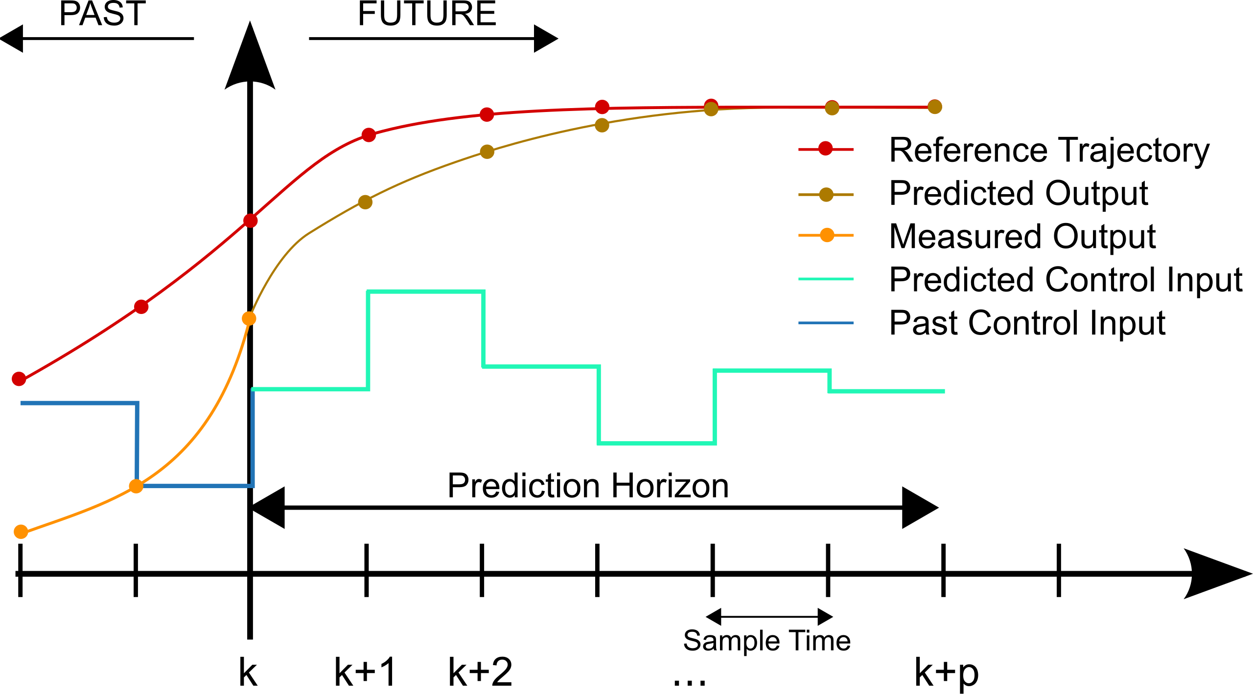
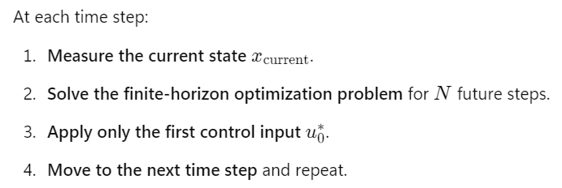
Model Predictive Control (MPC)
MPC uses a receding horizon approach to compute the optimal control input at each time step by solving a finite-horizon optimal control problem in real-time via online optimization using numerical methods.
Finite-horizon optimal control problem formulation:
James B. Rawlings, David Q. Mayne, Moritz M. Diehl, Model Predictive Control: Theory and Design, Nob Hill Publishing, 2nd ed., 2017

Slide 4
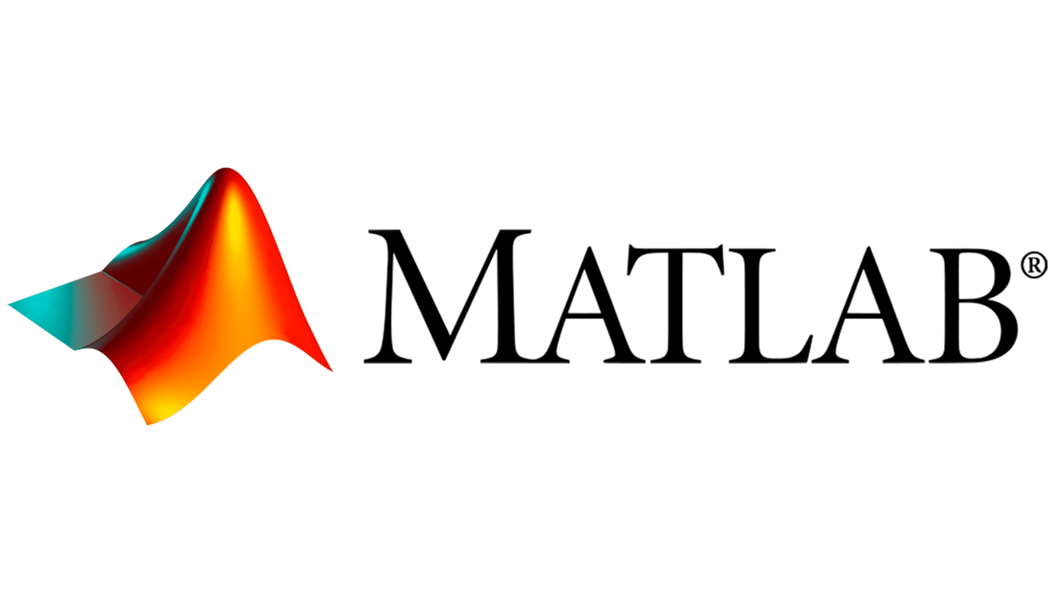



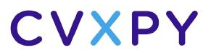
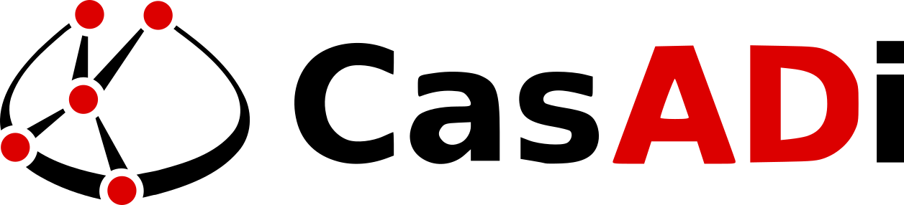
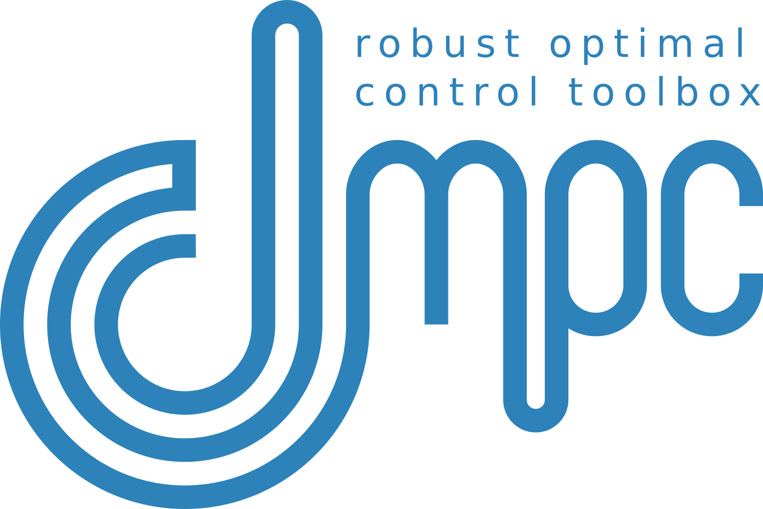

Model Predictive Control (MPC)
MPC uses a receding horizon approach to compute the optimal control input at each time step by solving a finite-horizon optimal control problem in real-time via online optimization using numerical methods.
Finite-horizon optimal control problem formulation:
MPC software tools:
Challenges: Computationally expensive online.
James B. Rawlings, David Q. Mayne, Moritz M. Diehl, Model Predictive Control: Theory and Design, Nob Hill Publishing, 2nd ed., 2017

Slide 5
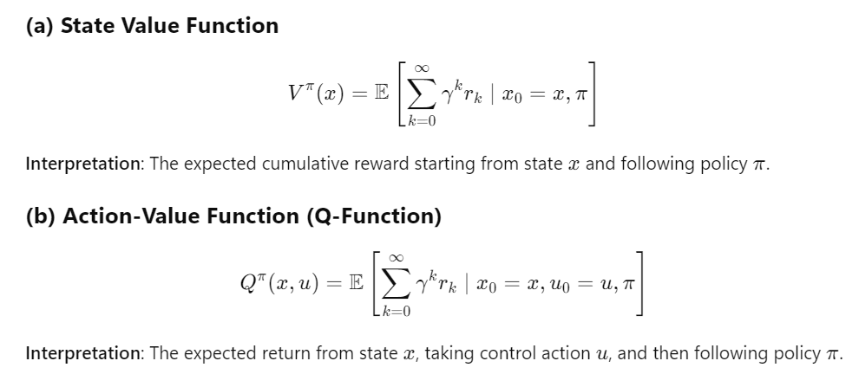
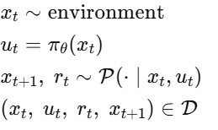
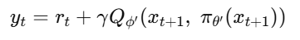
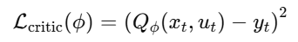
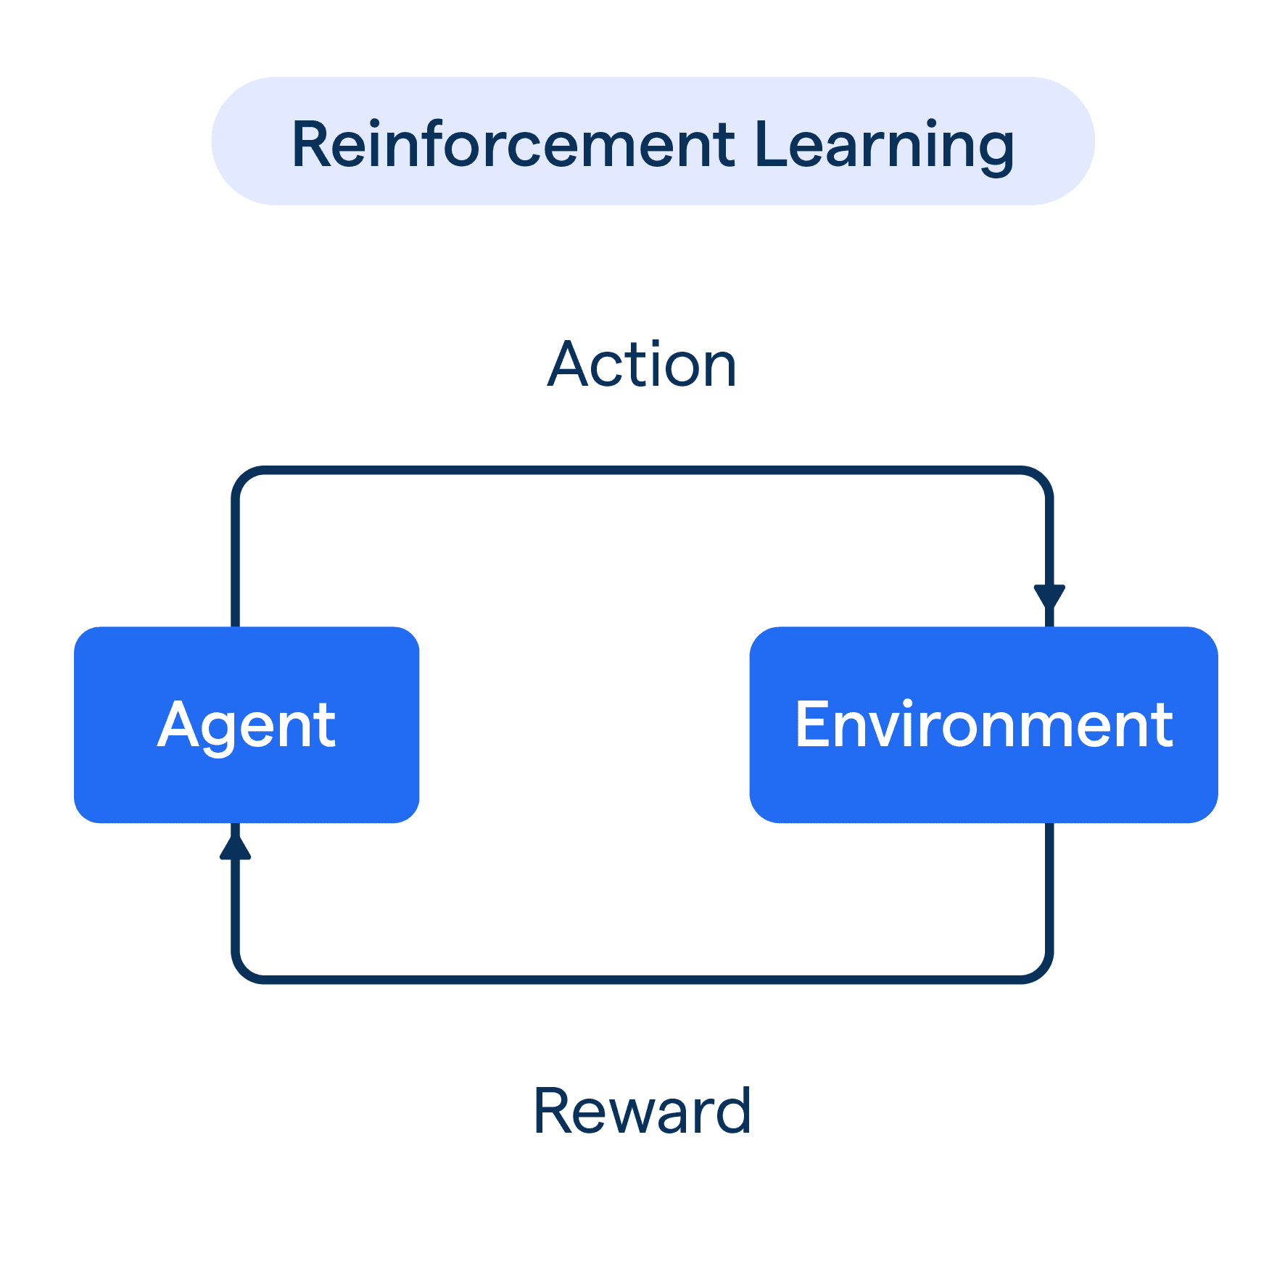
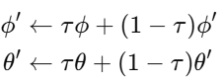
Reinforcement Learning (RL)
RL is a data-driven decision-making framework where an agent interacts with an environment to learn an optimal policy that maximizes rewards over infinite-horizon. Most modern policy-gradient methods (actor–critic, PPO, TRPO, DDPG, TD3, offline RL) learn a critic and use it to update the actor (policy).
1, Data collection via sampling:
2, Critic Update:
Q-function
Bellman target
Critic loss function
3, Actor update via deterministic policy gradient:
4, Gradient descent updates:
Richard S. Sutton and Andrew G. Barto, Reinforcement Learning: An Introduction, MIT Press, 2nd ed., 2018

Slide 6


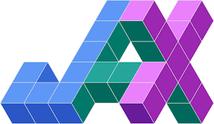

Reinforcement Learning (RL)
RL is a data-driven decision-making framework where an agent interacts with an environment to learn an optimal policy that maximizes rewards over infinite-horizon. Most modern policy-gradient methods (actor–critic, PPO, TRPO, DDPG, TD3, offline RL) learn a critic and use it to update the actor (policy).
1, Data collection via sampling:
2, Critic Update:
Q-function
Bellman target
Critic loss function
3, Actor update via deterministic policy gradient:
RL software tools:
4, Gradient descent updates:
Challenges: Sample inefficient! Hard to obtain guarantees.
Richard S. Sutton and Andrew G. Barto, Reinforcement Learning: An Introduction, MIT Press, 2nd ed., 2018

Slide 7
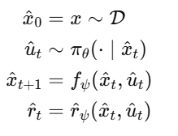
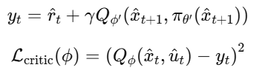
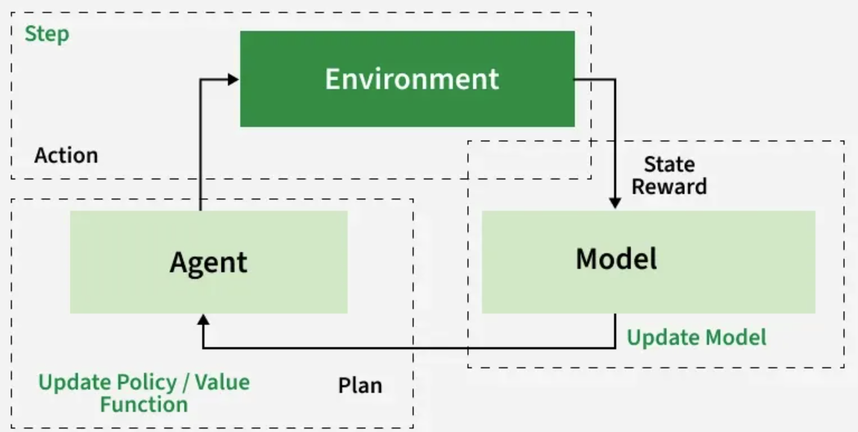
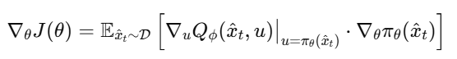
Model-Based Reinforcement Learning (MBRL)
MBRL aims to improve sample efficiency by learning a predictive model of the environment dynamics and using it to simulate trajectories for Q-function fitting and policy optimization. This framework is followed by methods such as MBPO, TD3-MB, MOPO, COMBO, DreamerV3, and Plan2Explore.
1, Model rollouts via sampling:
2, Critic Update using model rollouts:
Bellman target
Critic loss function
3, Actor update via deterministic policy gradient:
4, Gradient descent updates:
Image: www.geeksforgeeks.org/artificial-intelligence/model-based-reinforcement-learning-mbrl-in-ai/
Richard S. Sutton and Andrew G. Barto, Reinforcement Learning: An Introduction, MIT Press, 2nd ed., 2018

Slide 8
Model-Based Reinforcement Learning (MBRL)
MBRL aims to improve sample efficiency by learning a predictive model of the environment dynamics and using it to simulate trajectories for Q-function fitting and policy optimization. This framework is followed by methods such as MBPO, TD3-MB, MOPO, COMBO, DreamerV3, and Plan2Explore.
1, Model rollouts via sampling:
2, Critic Update using model rollouts:
Bellman target
Critic loss function
Why to learn the critic if we have accurate and differentiable model and parametric reward functions?
3, Actor update via deterministic policy gradient:
4, Gradient descent updates:
Image: www.geeksforgeeks.org/artificial-intelligence/model-based-reinforcement-learning-mbrl-in-ai/
Richard S. Sutton and Andrew G. Barto, Reinforcement Learning: An Introduction, MIT Press, 2nd ed., 2018

Slide 9
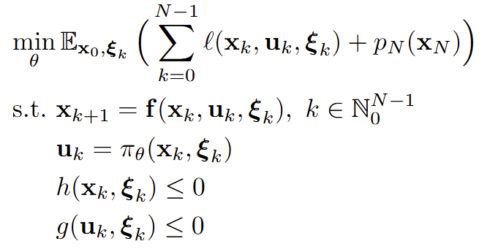
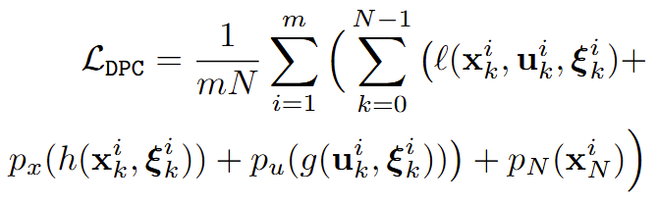
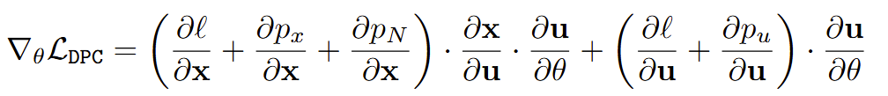

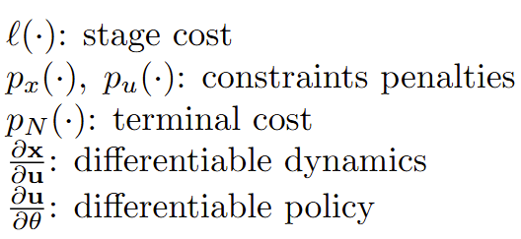
Differentiable Predictive Control (DPC)
DPC is closely related to MBRL in that both leverage model of dynamics, but DPC utilizes differentiable closed-loop models and cost functions, allowing direct policy gradients without requiring a learned critic.
Empirical risk minimization problem:
Critic parametrized by differentiable MPC-like loss function:
Policy gradient via automatic differentiation:
J. Drgoňa, A. Tuor and D. Vrabie, Learning Constrained Parametric Differentiable Predictive Control Policies With Guarantees, in IEEE Transactions on Systems, Man, and Cybernetics: Systems, 2024
J. Drgoňa, et al., Differentiable Predictive Control: An MPC Alternative for Unknown Nonlinear Systems using Constrained Deep Learning, Journal of Process Control, 2022

Slide 10
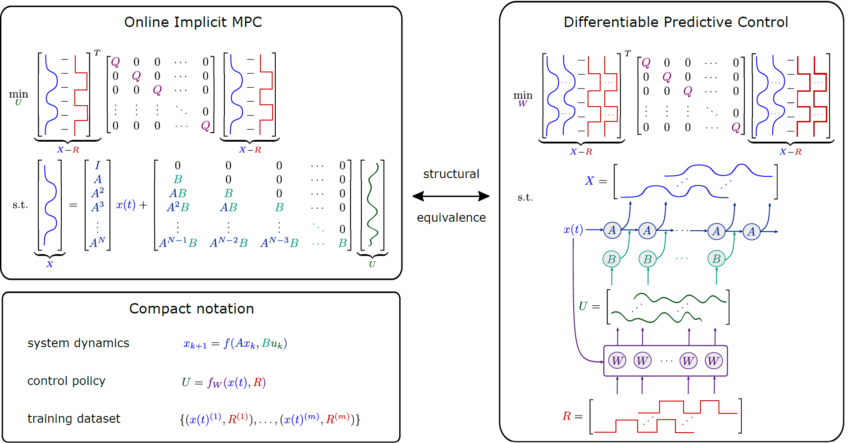
Differentiable Predictive Control (DPC)
DPC is also closely related to explicit MPC, as it solves a parametric optimal control problem; but instead of on intractable multi-parametric programming, it employs direct gradient-based policy optimization.
There is a structural equivalence between single shooting formulation of MPC problem and the unrolled closed-loop system dynamics in DPC.
But instead of online optimization as in implicit MPC, the DPC learns explicit policy offline, similarly to RL.
J. Drgoňa, A. Tuor and D. Vrabie, Learning Constrained Parametric Differentiable Predictive Control Policies With Guarantees, in IEEE Transactions on Systems, Man, and Cybernetics: Systems, 2024
J. Drgoňa, et al., Differentiable Predictive Control: An MPC Alternative for Unknown Nonlinear Systems using Constrained Deep Learning, Journal of Process Control, 2022

Slide 11
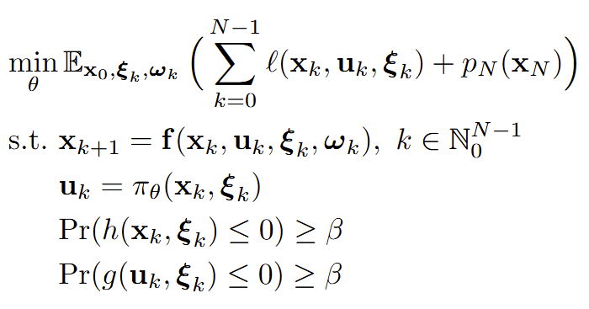
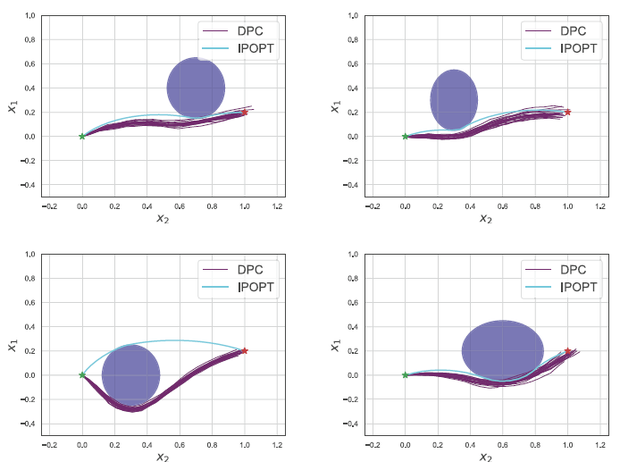
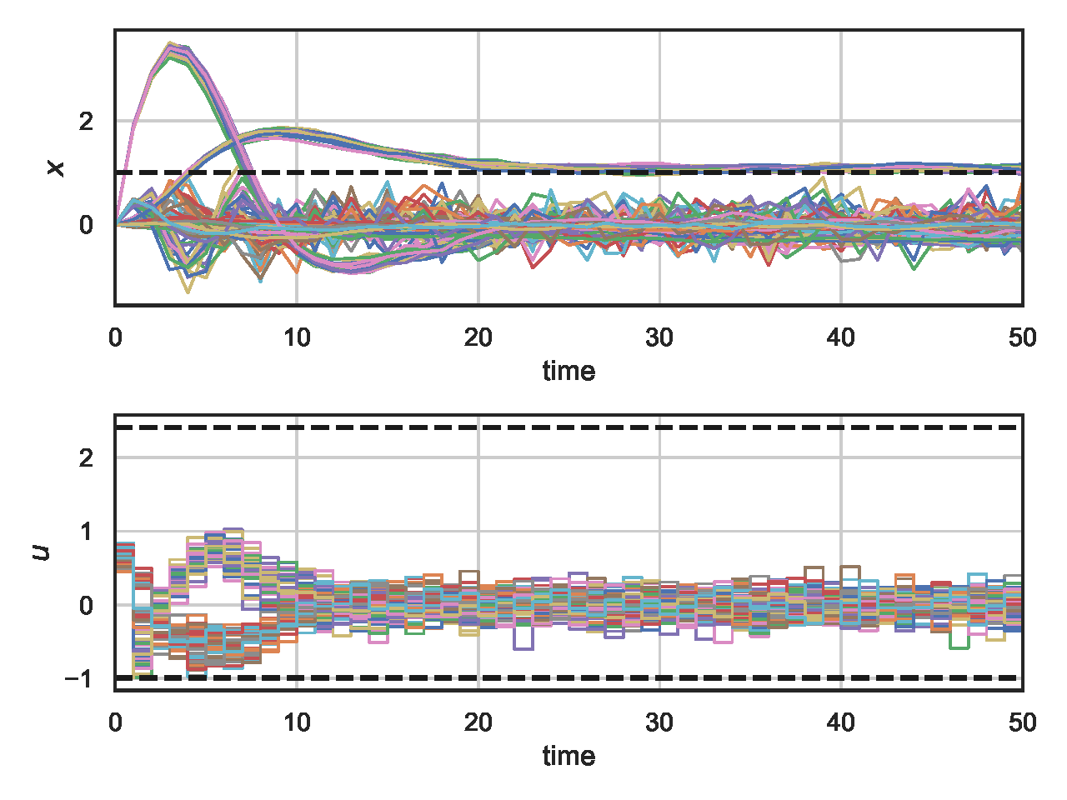
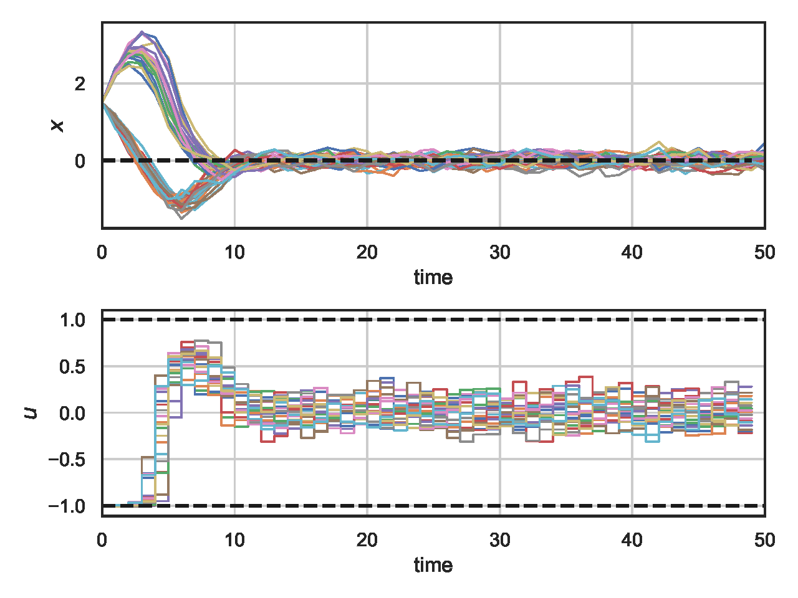
Stochastic Differentiable Predictive Control
DPC naturally generalizes to handle parametric stochastic optimal control problem formulations via joint sampling of control parameters and uncertainties.
Can handle both parametric and additive uncertainties, and wide range of task parametrizations such as reference tracking, stabilization, time-varying constraints, or obstacle avoidance.
Ján Drgoňa, Sayak Mukherjee, Aaron Tuor, Mahantesh Halappanavar, Draguna Vrabie, Learning Stochastic Parametric Differentiable Predictive Control Policies, IFAC-PapersOnLine, Volume 55, Issue 25, 2022

Slide 12
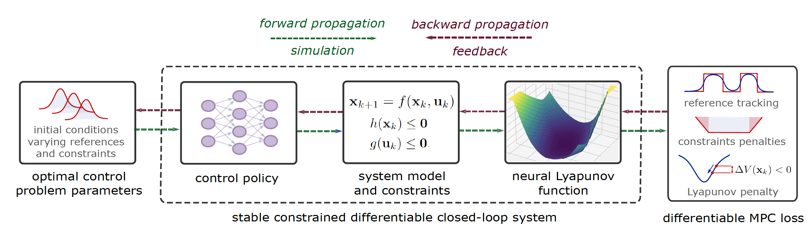
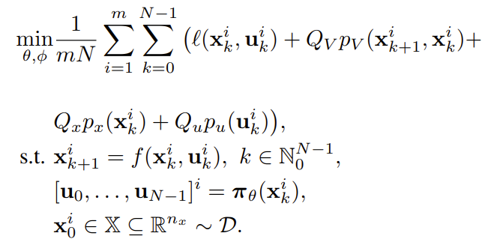
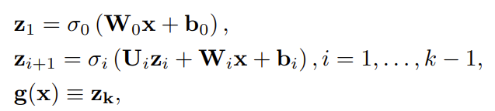
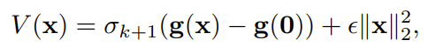
DPC with Neural Lyapunov Functions
Joint learning of neural policy and Lyapunov function:
Neural Lyapunov function candidate via input-convex neural network (ICNN) architecture:
Discrete-time Lyapunov penalty:
S. Mukherjee, J. Drgoňa, A. Tuor, M. Halappanavar, D. Vrabie, Neural Lyapunov Differentiable Predictive Control, CDC, 2022
Gaurav Manek, J. Zico Kolter, Learning Stable Deep Dynamics Models, NeurIPS 2019

Slide 13
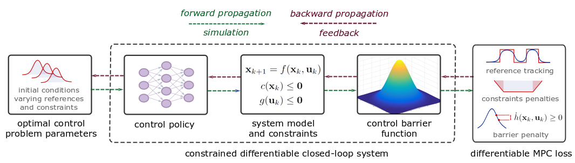
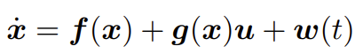
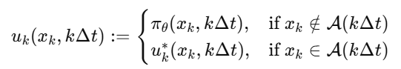
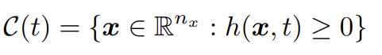
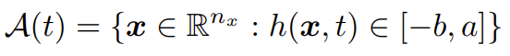
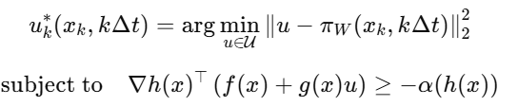
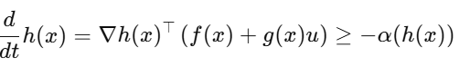
DPC with Control Barrier Functions
Let’s consider perturbed control-affine system:
Learned DPC policy with CBF safety filter:
Define a safe set and its boundary:
CBF safety filter implemented as QP:
Control Barrier Function (CBF) condition:
W. S. Cortez, J. Drgoňa, A. Tuor, M. Halappanavar, D. Vrabie, Differentiable Predictive Control with Safety Guarantees: A Control Barrier Function Approach, CDC, 2022 A. D. Ames, et al., Control Barrier Functions: Theory and Applications, ECC, 2019

Slide 14
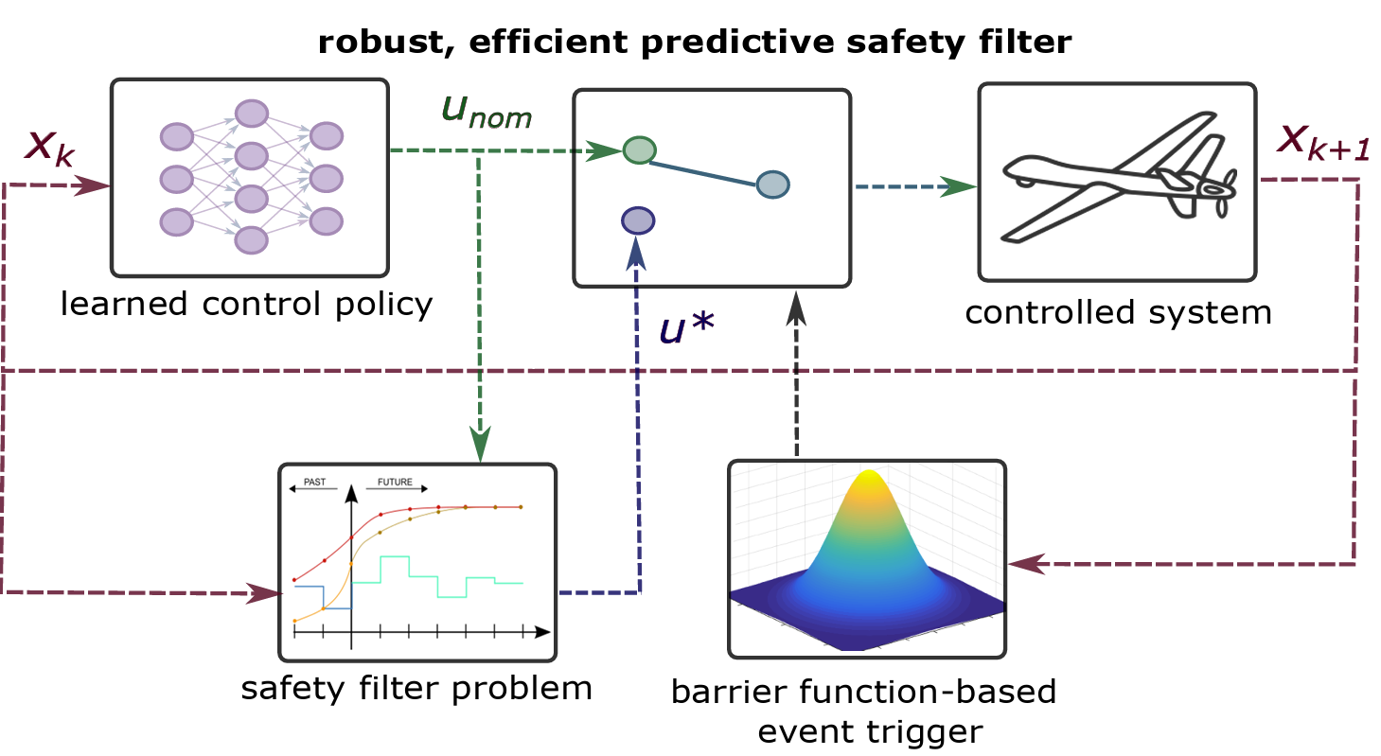
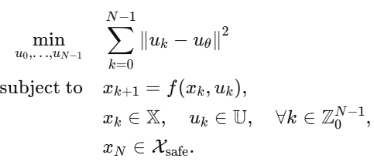
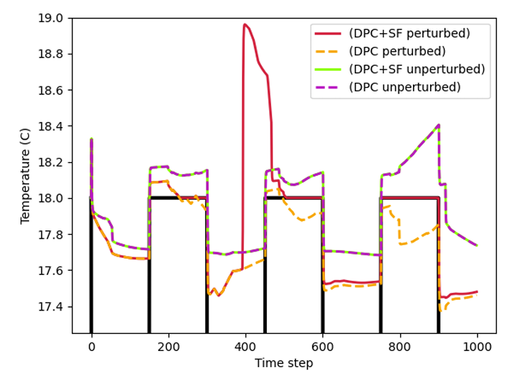
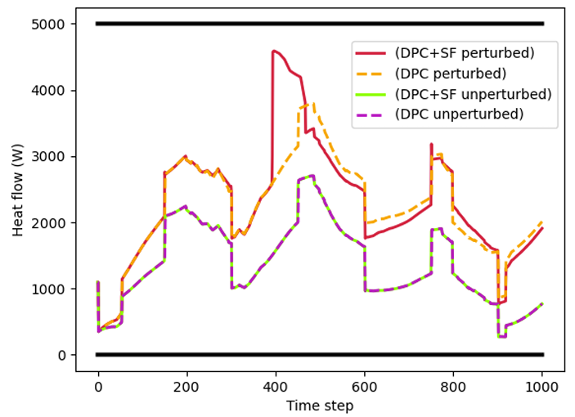
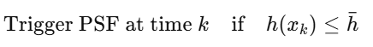
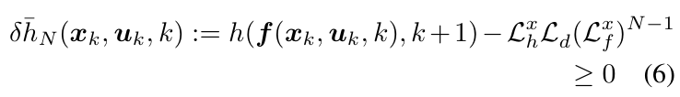
DPC with Predictive Safety Filters
Predictive safety filter (PSF) problem:
N-step robust barrier function event trigger:
N-step ahead robust safety condition:
Wenceslao Shaw Cortez, Jan Drgona, Draguna Vrabie, Mahantesh Halappanavar, A Robust, Efficient Predictive Safety Filter, arXiv:2311.08496, 2024
K. P. Wabersich, M. N. Zeilinger, A predictive safety filter for learning-based control of constrained nonlinear dynamical systems, Automatica, 2021

Slide 15
DPC with Predictive Safety Filters
Predictive safety filter (PSF) problem:
N-step robust barrier function event trigger:
Just like RL or approximate MPC, DPC learns neural control policy and is compatible with most modern safety filter methods for learning-based control.
Wenceslao Shaw Cortez, Jan Drgona, Draguna Vrabie, Mahantesh Halappanavar, A Robust, Efficient Predictive Safety Filter, arXiv:2311.08496, 2024
K. P. Wabersich, M. N. Zeilinger, A predictive safety filter for learning-based control of constrained nonlinear dynamical systems, Automatica, 2021

Slide 16


Data-driven DPC for Building Energy System Optimization
Benefits of DPC vs MPC
Modeling and optimal control design is roughly 10-times faster and requires less modeling expertise.
Real-time decisions are made orders of magnitude faster than traditional model-based approaches.
J. Drgona, et al., Physics-constrained deep learning of multi-zone building thermal dynamics, Energy and Buildings, 2021
J. Drgona, et al., Deep Learning Explicit Differentiable Predictive Control Laws for Buildings, IFAC NMPC 2021

Slide 17
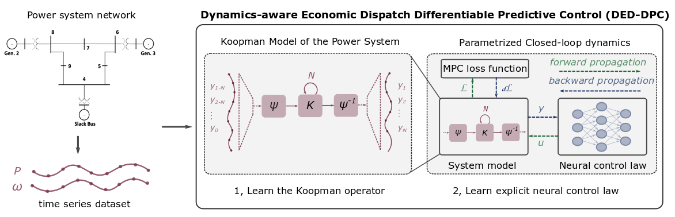
Data-driven DPC for Power System Optimization
Benefits of DPC vs MPC
Fast prototyping by re-using code template from building control project.
Real-time decisions are made orders of magnitude faster than traditional model-based approaches.
Ethan King, et al., Koopman-based Differentiable Predictive Control for the Dynamics-Aware Economic Dispatch Problem, American Control Conference 2022

Slide 18








Acknowledgements
Aaron Tuor
Wenceslao Shaw Cortez
Ethan King
Sayak Mukherjee
Mahantesh
Halappanavar
Draguna
Vrabie

Slide 19

Try DPC Yourself in Neuromancer!
Open-source library in PyTorch
Physics-informed Neural Networks
Learning to optimize
Neural differential equations
Differentiable predictive control
github.com/pnnl/neuromancer

Slide 20

Summary
Differentiable Predictive Control
MBRL algorithm inspired by explicit MPC
Differentiable system models and rewards
Avoids learning the critic
Direct policy optimization
Compatible with modern safety filters
Ongoing Research
UQ and Robust DPC
Offset-free and online adaptive DPC
Dealing with mixed-integer decisions
Dealing with vanishing and exploding gradients
Control of PDEs
Applications in large-scale energy systems
drgona.github.io jdrgona1@jh.edu
github.com/pnnl/neuromancer

